Slide 1


Facial Image Analysis for Early Autism Detection in Children

Slide 2
Limited accessibility
Late diagnosis
What are the main problems?
Awareness and understanding

Slide 3
1
Facilitate early intervention and care
2
Enhance well-being and quality of life
Our Goals
3
Raise awareness about autism

Slide 4
Facial Image Analysis for Early Autism Detection in Children
ASD screening solution using facial images and transfer learning-based deep learning techniques
Project Idea
Unique collection of clinically diagnosed children with ASD, including facial images of both autistic and non-autistic children.
Our Solution?
Dataset
CNN, 9Layer
Algorithm
facial images of both autistic and non-autistic children, We split the dataset into three parts: 70% for training, 15% for testing, and 15% for validation.
Training / Testing / Validation
78.31%
Accuracy

Slide 5
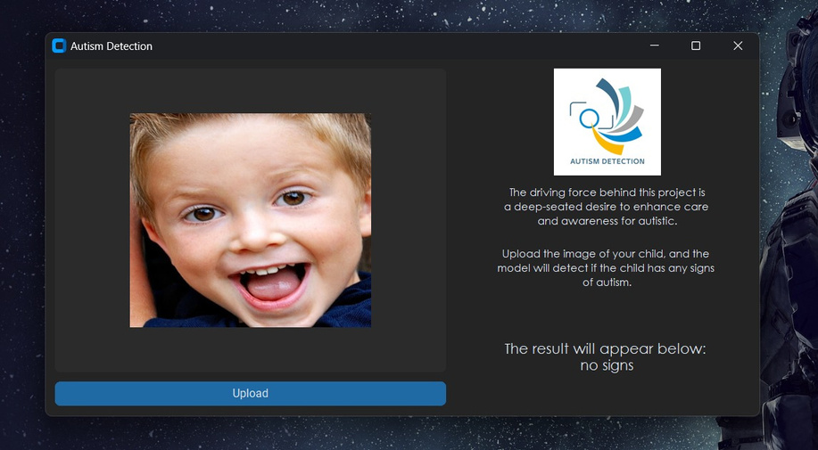
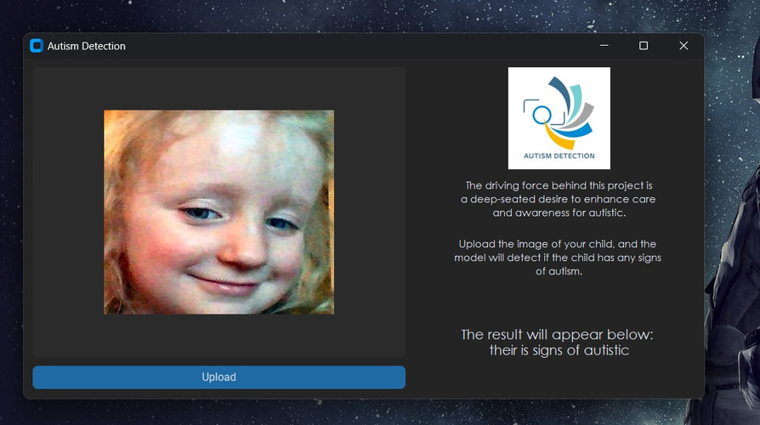
The Result is Displayed on Our Website as Follows:

Slide 6
Thank You for Listening

